Slide 1
STUDENT CANDIDATE NUMBER (given by Examinations and available on Portico): | ZXSW1
DO NOT WRITE YOUR OWN NAME ON THIS SHEET
Personal Tutor Name | Tu Dong
Module name and code | Interaction Design COMP0012
Name of teacher who set this work | Chris Evans
Coursework Title | Interaction Design Assignment
Submission deadline | 20/03/2019
Page count | 23 (This included)

Slide 2
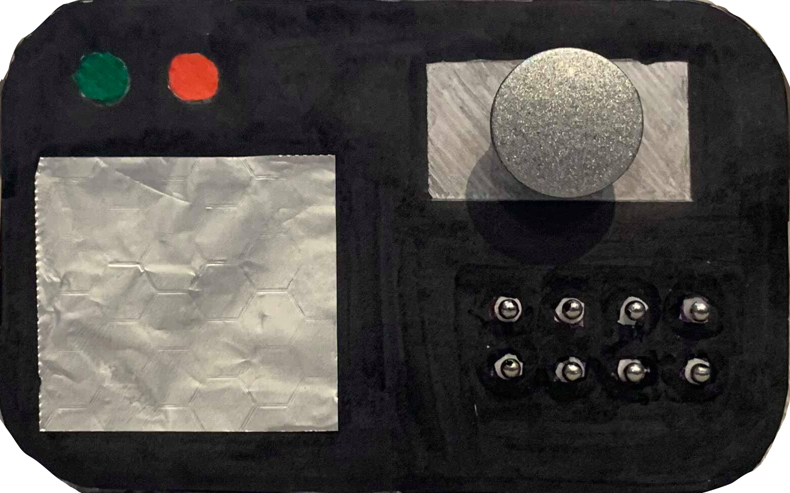
Design and Evaluation of YouLock
Biometric Verification Door Locking System
Notes:
ADD CANDIDATE NUMBER HERE

Slide 3
Overview
Introduction to the Product
User Research
Evaluation of Alternatives
Personas, Scenarios and Storyboard
User Requirements
Prototyping: Wizard of Oz
Final Evaluation
Reflection on Interaction Design Process
Further Recommendations
References

Slide 4
Introduction to the Product
A door locking system which identifies the user’s fingerprint and face to secure access to their house
  Equipped with fingerprint scanner, face recognition system
Voice activated commands
  Access and scheduling options modified through mobile application
Encrypted security system including alarm
Objectives
Decrease user risk of getting locked out of their house
Ensure that only authorized users can unlock the door
Eliminate the need for using and carrying keys
How does it work?
The user sets up their administrator account by scanning their fingerprint and face
Once the user is outside the door, the device analyses their finger and face to determine access
Multiple users can be granted access accounts through the administrator’s mobile app
Option to include additional finger scanner for building access

Slide 5

Initial User Research: Goal Setting
Get insight on users’ key usage experience:
  Frequency of experiencing key related problems
  Most common causes for getting locked out (pain points)
  Identify user maturity concerning innovative home solutions
  Analyse user change-proneness on conventional key usage
Studying behavior of different demographics
Measuring the extent to which getting locked out is identified as a solution-seeking problem

Slide 6
Initial User Research: Methodology
Online Survey
  Data Protection: Anonymity across survey, focus group
  Questions: 5 multiple choice, 1 checkbox
Focus Group
  Reasons:
  Reaching respondents quicker
  fast response rates
  test assumptions effectively and with logical sequence
SurveyMonkey questionnaire distributed through Facebook and WhatsApp IMB group, family friends, 25 respondents out of 120
  Sample partially distorted due to limited respondent segments (low percentage of adults over 30-under 64)
  Accurate representation of young adults (18-24)
  Reasons:
  Qualitative feedback
  unbiased opinions
  outsider’s view
  Interdisciplinary group of 5 London university students, face-to-face meetings
  Reflection on survey
  brainstorming of means to eliminate the possibility of key trouble

Slide 7
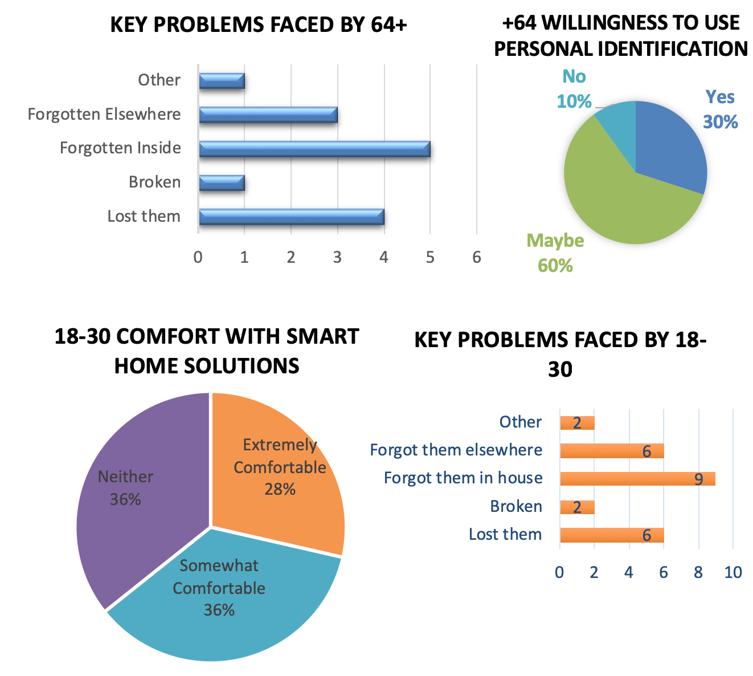
Research Findings: Online Survey
10/10 of 64+ survey takers have been locked out
  50% have forgotten their keys inside their house
  30% is somewhat comfortable, and another 30% is somewhat uncomfortable with smart home solutions
  Only 10% would say no to personal identification methods for house access
13/14 of survey takers between 18-30 have been locked out
  Forgetting keys inside the house is once again the most common problem faced, with 64%
  28% are extremely comfortable with smart home solutions, 0 responses linked to discomfort (Likert scale)
  64% would use personal identification methods for house access

Slide 8

Research Findings: Focus Group
Comments on key usage
  “It is annoying having to refer to a locksmith whenever you face issues with your keys, in a busy city like London; (you are) probably going to wait for more than half an hour”
  ”One of the few remaining aspects of our daily lives that has been maintained so constant throughout the years”
  “There should have already been a trend towards digital locking systems. It is a shame for one living on this day and age to get locked out of their own property”
Pain points
  “Having to leave the house urgently, I often cannot remember where I placed my keys, forcing me to search bags, jackets etc.”
  “This mini-heart attack I get whenever I arrive outside my door and can’t feel my keys in my pocket”
  “When somebody is staying over, like friends or family, having one pair of keys limits our daily schedule”
  “Whenever I have to do chores that require me to even briefly get out of my flat, like taking out the garbage, I still need to look for my keys and take them with me”
Recommendations
  “Substitute the use of keys with modern means of security technology.”
  “Get the door to know that you are its main user”
  “(A system that can) Identify visitors and inform users of people standing outside door”
  “a solution that tackles necessity to unlock multiple doors, for instance in apartment buildings"
Coping strategies (when locked out)
  “Called the Locksmith, waited for around 40 minutes and spent 100£ to get my door unlocked”
  “Tried to climb through the window but resulted to calling the Locksmith”
  “Stayed the night at a friend’s house because it was too late”

Slide 9

Research Findings: Summary
The majority of survey takers have been locked out of their house at least once
Main key problems faced are linked to forgetting or losing them
Ages 18-30 show sufficient familiarity with smart home solutions, with zero negative responses
Mixed perceptions of smart home solutions for 64+
Majority would rely on personal identification methods for house access
Very limited options in case of being locked out – Locksmith is almost always the solution
Device has to:
be easy to use 🡪 voice commands
Allow access to authorized users through personal identification methods (fingerprint, face scan)
notify user of people standing outside the door
be alarm activated
eliminate need to carry keys

Slide 10
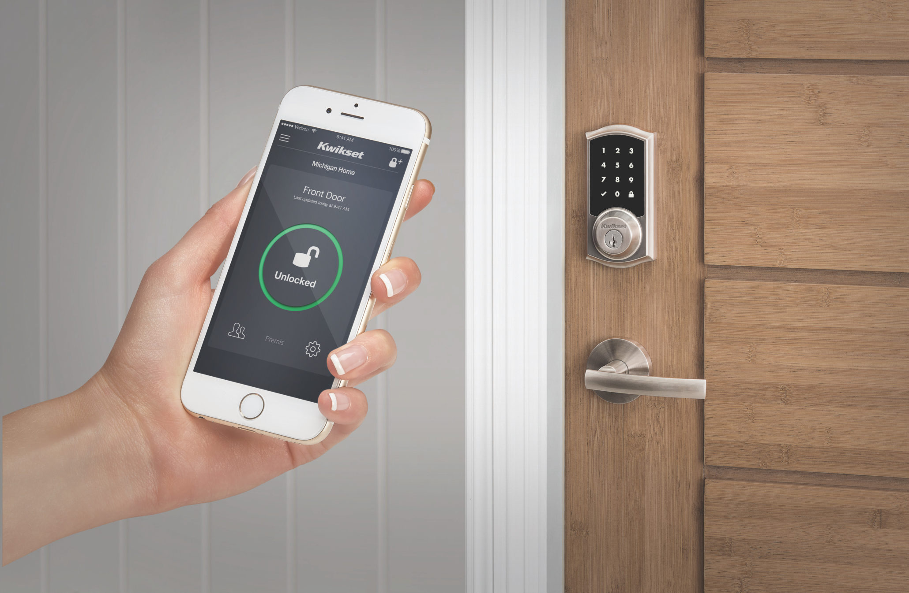
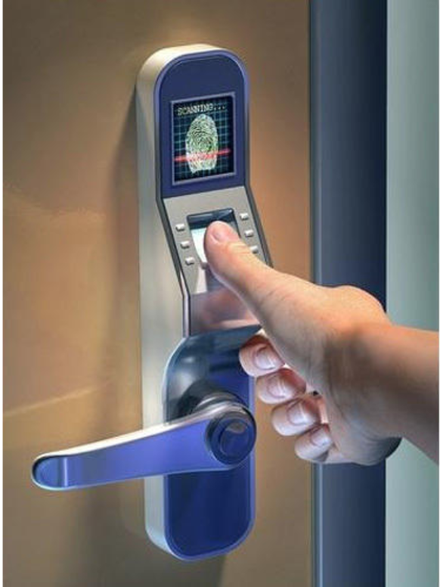
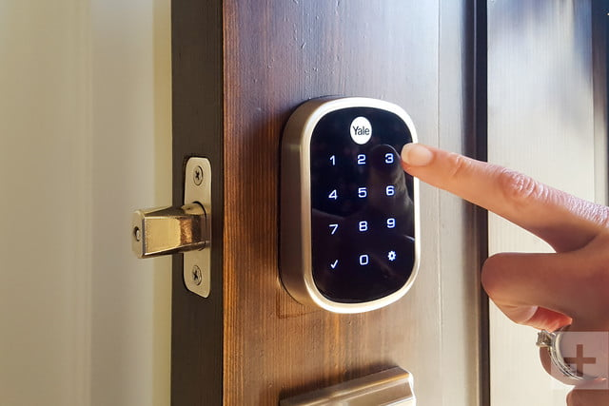
Development of Ideas: Evaluation of Alternatives
Activity based conceptual models (Preece, Sharp and Rogers, 2015):
Instructing: Commanding the device for access and scheduling
Conversing: Device acknowledges admin commands and informs them
Goal: Help users access their house easier & safer
Device: Sophisticated Digital Locking System
2) Phone-Activated Lock
3) Finger Scan Lock
Unlocks door when smartphone with designated mobile application account is nearby
Fingerprint scanner attached to door handle determines access to house
Identifying visitors to determine house access
1) Keypad Lock
User sets up and uses multi-digit passcode to unlock door

Slide 11
Development of Ideas: Evaluation of Alternatives
Ensure integrity of administrator
Interact with the user
Identify authorized users
Eliminate need for key usage
Inform in the case of visits
Device Selection – Focus Group
1) Keypad Lock
2) Phone-Activated Lock
3) Finger Scan Lock
Complex to disarm without knowledge of passcode
No need for unlocking hardware
Anyone with knowledge of passcode can gain access-no administrator function
Users are not identified
Phone access limited to authorized in-app accounts
Assigns unlocking function to devices routinely carried by users
Visits by unregistered users are not acknowledged by the device
Keyhole and passcode options 🡪 proneness to breach
Eliminates need for unlocking hardware
High security biometric verification for user access
Administrator identification
Unregistered visitors not identified
Limited interaction with user

Slide 12

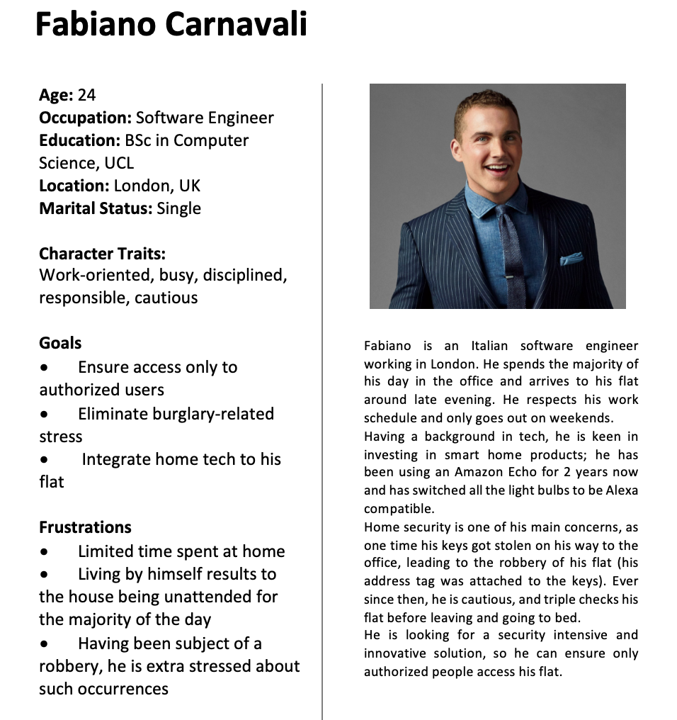
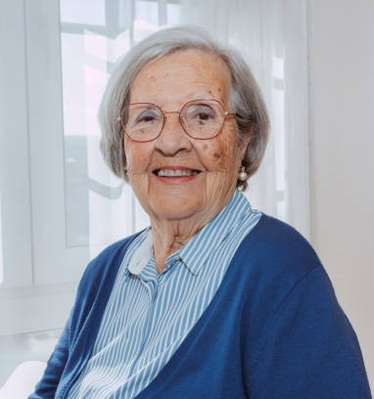
Personas

Slide 13

Scenarios
Scenario 1
Meredith has invited her son and daughters for lunch at 2PM. Having just finished her Bingo session, she heads back home at 1:30PM. It takes her 10 minutes to get back. Once at the front door, she scans her finger on YouLock, which identifies her face and greets her home, providing her access. She informs the YouLock that she is expecting her children soon. As she is cooking, her children are at the door. She does not need to pause her cooking to open, as they have been registered as authorized users, as well as expected by the YouLock according to Meredith’s recent instruction; they can open the door once authorized by the YouLock. Meredith finds this device useful as it simplifies a procedure that troubled her in the past, and she is well aware that she will not be facing key issues any time soon.
Scenario 2
It is Wednesday and Fabiano returns home after work, in the evening. The YouLock grants him access to his flat. He then instructs it to lock the door, as he is going to take a nap and wants to be care-free. Around 9PM, he receives a notification through the YouLock app, informing him of a visitor at the door. As he is not expecting anybody, he accesses the app’s camera (peephole) view option. After recognizing his close friend, Jason, standing outside his door, he opens for him. Jason, who lives nearby, visited Fabiano to ask for some olive oil, as he was out. Jason was confused, as he had already registered an access account to Fabiano’s flat and tried scanning his finger to gain access. Fabiano then explained to him, that the YouLock does not allow access to non-admin registered accounts unless instructed by the administrator. Fabiano is pleased with his new device, allowing him full access control to his flat. It is reassuring for him to be informed of visitors standing outside the door, even when he is not at home. He is satisfied having replaced his keys with a smart solution requiring just his physical features to operate.

Slide 14
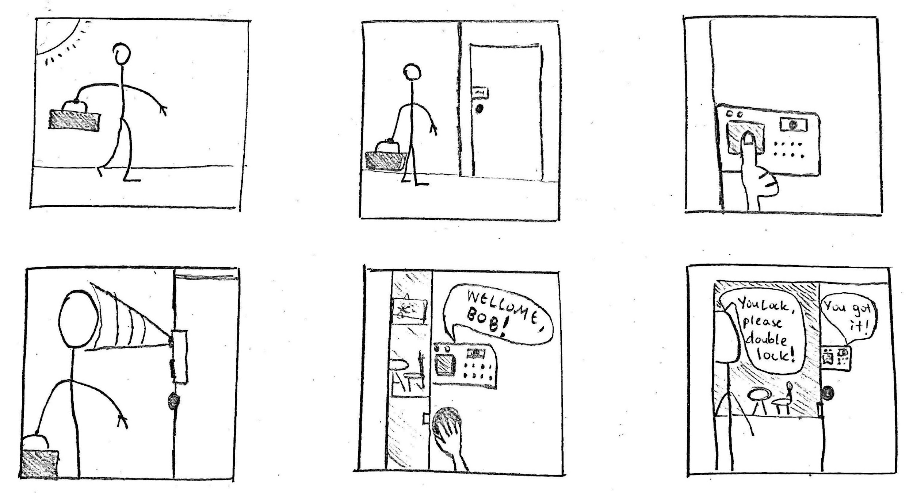
Storyboard
1) Bob is heading home after a long day at work
2) Bob approaches his front door
3) He scans his fingerprint on the YouLock
4) After validating his fingerprint, YouLock scans Bob’s face
5) Ensuring Bob is the user, YouLock greets and grants him access
6) Before closing the door, Bob asks YouLock to double lock, and it informs him of its acknowledgement of the command

Slide 15
User Requirements
Functional Requirements
The device must | determine user permission rights through finger and face scan identify its main user as the administrator inform the administrator of visits notify the administrator of failed access requests allow admin to view peephole through mobile app operationally and verbally respond to admin voice commands acknowledge lock, expect a visitor or set security mode commands
The device should | account for predefined scheduling options have a built-in alarm for security capture peephole snapshots in case of failed access requests
The device could | notify security/police services in case of breach
Non-Functional Requirements
The device must | identify input from additional authorized users and condition their access be instantly responsive once the camera identifies a person nearby be equipped with recovery battery in the case of power outage disregard commands sent by unauthorized users
The device should | include a voice tutorial to assist users in setting up the device Account for presence logic – acknowledge that admin is within the property or away
The device could | not be constantly running when the door is not used to conserve energy wake when the camera identifies a visitor
User Experience Requirements
The device must | retrieve voice commands from user engage in a realistic and simple conversation communication channel with the user
The device should | be appropriately scaled for easy use, while maintaining a slick and unbulky design

Slide 16
Development of Ideas –Thinking Aloud/Wizard of Oz
Thinking Aloud
Wizard of Oz
Users’ physical interaction with prototype allows in-depth feedback
Prototype development can be organised in consecutive iterations based on feedback
Recording
Getting a closer look into the user’s mindset
Identifying the steps taken when interacting with the device for the first time
Can be applied concurrently with Wizard of Oz technique
Voice Memos
Meeting Notes
Convenience Sampling – Participants from university course
Participants:
Small sample size
All participants have been subject to issue to be solved (locked out)
5 3rd Year IMB Students
Sample-wide experience in interaction design, smart products & innovation
Evaluation
1) Demonstrating device objective and functions
2) Thinking Aloud: Assessing first iteration, users requested to simulate their interaction
3) Tackled issues converted to improvements in consecutive iterations
4) Wizard of Oz: Simulate device responses on user commands
5) Cross-checking findings with participants for further input

Slide 17
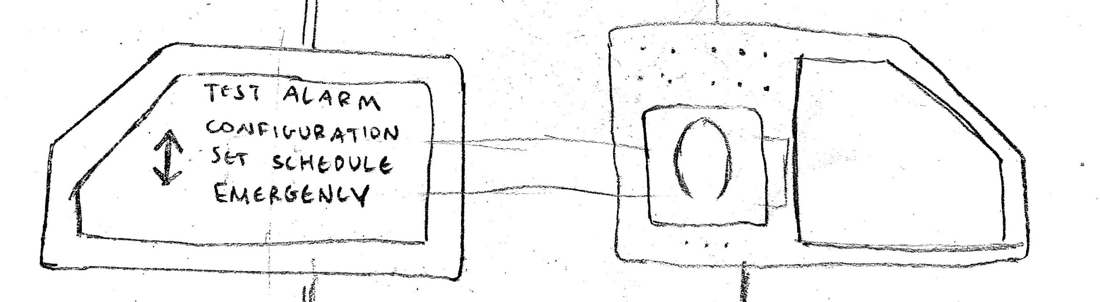

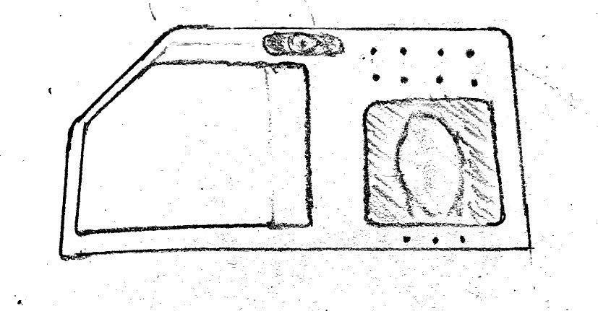
Development of Ideas –Thinking Aloud/Wizard of Oz
Iteration 1
Iteration 3 (Final)
Two compartments-one inside door, one outside
Large outside button - doorbell
Inside compartment responsible for setting up accounts and scheduling
Finger print – sole identification method
“Hard to fuse an independent sophisticated and simple UI”
“It might turn out complicated to install a dual-compartment device connected through a wall”
“There is risk in solely relying on fingerprint for access”
Exclusion of doorbell allows for smoother design and placement of compartments
Voice assistant interacting with user
Peephole view through mobile app
Addition of optional mini-finger-scanner for building access
”It is reassuring to have a multi-method security system with all methods verifying personal identity”
“Plus marks for sonification, you know if the device understands you”
“This way, you can be aware of visitors, even when you’re away”
Iteration 2
Single device placed on door’s outside
Face recognition camera included
Voice commands
Access and scheduling handled through mobile application
”No need to include doorbell, occupies space”
“Device should vocally respond to voice commands”

Slide 18
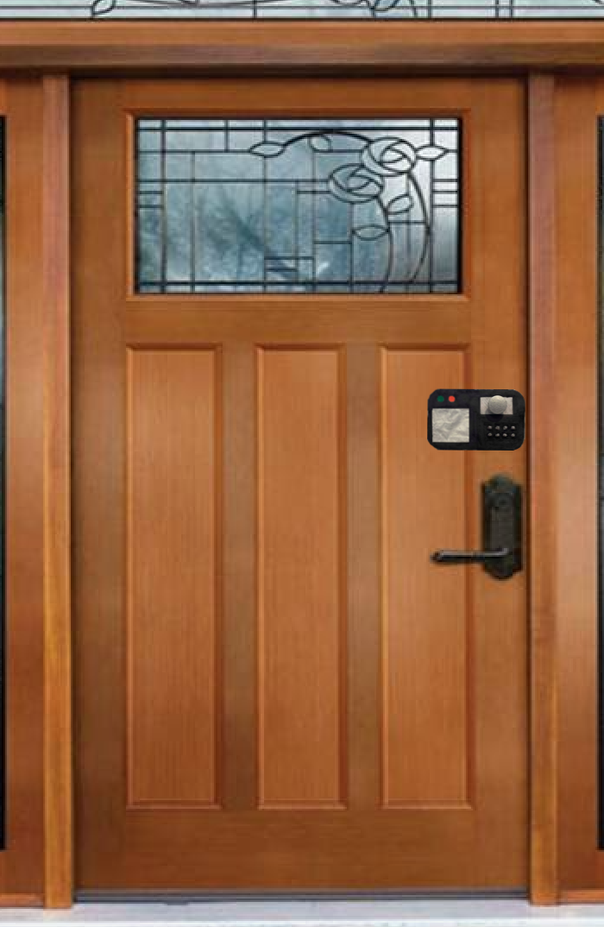
Final Product Idea
YouLock is a biometric locking device that allows users to access their property effortlessly, without the need to carry unlocking hardware.
Face-Recognition Camera
Binary Access Display (Green, Red)
Speaker/Microphone
Main User Pain Points
Frequency of key-related issues resulting to getting locked out | YouLock eliminates the need to carry keys, as it only requires a fingerprint and face scan to provide access
Anyone with possession of key can access property | Users’ fingers and faces work as “keys”, therefore access is limited only to registered, authorized ones
Limited ability for home supervision when away | YouLock notifies the administrator through the mobile application in the case of visits, allows them to view peephole
Fingerprint Scanner
Additional building access finger scanner

Slide 19
Prototype Evaluation – Heuristics Evaluation
Why?
Usability guidelines to compare design
Eliminate system bottlenecks
Discover improvements with no need to consult users
Visibility of system status | ✔ | Green light for access granted, red light for access denied, vocal feedback on user commands
Match between system and real world | ✔ | YouLock greets user and responds to commands through everyday language and phrases
User control and freedom | ✔ | User can undo any voice commands by instructing “undo” and configure further access options through mobile application
Consistency and standards | ✔✖ | The device is compatible with alternative vocabulary for identification of voice commands, possibility of unregistered vocabulary combinations
Error prevention | ✔ | Device ensures every new authorized user is authenticated by the administrator, and conditions their access depending on their rights
Recognition rather than recall | ✔ | User can vocally enquire about available functions at certain stages and YouLock will respond. They can also enquire about recent access through interacting with the device, as well as the app
Flexibility and Efficiency of Use | ✔ | Experience not required thanks to voice activated commands, device identifies each user’s admin-defined access rights
Aesthetic and Minimalist Design | ✔✖ | Device physical components are limited to necessary functions. LED access indicators could be replaced by one, conditionally flashing green or red light.
Help users recognize, diagnose, and recover from errors | ✔ | Device vocally informs user in case of error in command or operation.
Help and documentation | ✔✖ | Voice tutorial upon device installation. No documentation included, help button may be deemed useful.

Slide 20
Reflections on Interaction Design Process
 | Strengths | Limitations | Problems Faced
ID Process | Main focus is always on users, identifying their needs in requirements stage, and observing their interaction with prototype to measure effectiveness | No opportunity for secondary component development (mobile application prototype) | Limited insight on user interaction with the device from a distance
Online Survey | Testing hypotheses concerning user pain points and insight on key usage | Time constraint resulting to limited sample size, hard to analyse qualitative questions with varying inputs | Incorrect formatting of one question lead to re-publishing of survey, requiring deletion of existing responses
Focus Group | Aiming to cross-check survey-validated hypotheses with real users. Specification of main issues faced, and available solutions | Insight coming from just 5 individuals may be subject to bias | Hard to synchronize meeting for concurrent presence of group members, due to tight university schedule
Wizard of Oz | Users interacting with early iterations of product, determine improvements leading to the final prototype | Limited number of users | Conflicting user opinions on certain design and functional aspects
Heuristic Evaluation | Performing a cross-check through predefined requirements to measure effectiveness of solution | Absence of users | Designer bias – hard to identify unspotted issues due to full focus on internal perspective

Slide 21
Interaction Design Process Summary
Identifying requirements through survey and focus group
Determining user pain points and problem solving process
Evaluating alternative solutions
Constructing personas and relative scenarios, storyboard
Primary Research
Establishing Requirements
Phase 1
Personas, Scenarios
Designing Alternatives
Evaluating
Acquiring insight through Thinking Aloud, Wizard of Oz techniques to improve prototype
Move from low-fidelity sketches to high fidelity prototype
Phase 2
Heuristics Evaluation
Wizard of Oz, Thinking Aloud
Prototyping
Heuristics evaluation to conduct final usability analysis
Recommendations for future use
Storyboard
Physical Prototype
Phase 3

Slide 22
Conclusions and Next Steps
Younger generation keen in integrating smart tech with home security
Key trouble resulting in frustration for users, limited existing solutions – pricey, time consuming
High frequency of key issues in properties with more than one tenant
Limited home supervision when away concerns users
Conduct feasibility study of associated biometric technologies and methodology
Research with larger sample size to effectively measure user requirements and actual need for the proposed solution
Clear documentation of functionalities to determine their individual necessity
Take into account existing modern locking systems and focus on compatibility (e.g. allow YouLock to integrate with building door camera to view and determine guest identity)

Slide 23
REFERENCE LIST
Preece, J., Sharp, H. and Rogers, Y. (2015). Interaction Design - Beyond Human-Computer Interaction. 4th ed. Chichester: Wiley.
Buxton, B. (2010). Sketching User Experiences. Burlington: Elsevier Science.
Nielsen, J. (1994). 10 Heuristics for User Interface Design: Article by Jakob Nielsen. [online] Nielsen Norman Group. Available at: https://www.nngroup.com/articles/ten-usability-heuristics/ [Accessed 19 Mar. 2019].

